Slide 1


Slide 2

Unit 4: What time is it ?
Lesson 1

Slide 3

Unit 4: What time is it ?
Lesson 1
1.Look, listen and repeat:
Time
O’ clock
It’s time for …
It’s time to get up
Have to go home
A. M
P. M
: Thời gian
: Giờ
: Đó là thời gian cho ...
: Đó là thời gian để thức dậy
: Phải về nhà
: Sáng
: Chiều

Slide 4

Read and match :
Time
O’ clock
It’s time for …
It’s time to get up
Have to go home
A. M
P. M
Giờ
Đó là thời gian để thức dậy
Sáng
Đó là thời gian cho ...
Thời gian
Chiều
Phải về nhà
Let's look at the conversation in English on page 6

Slide 5

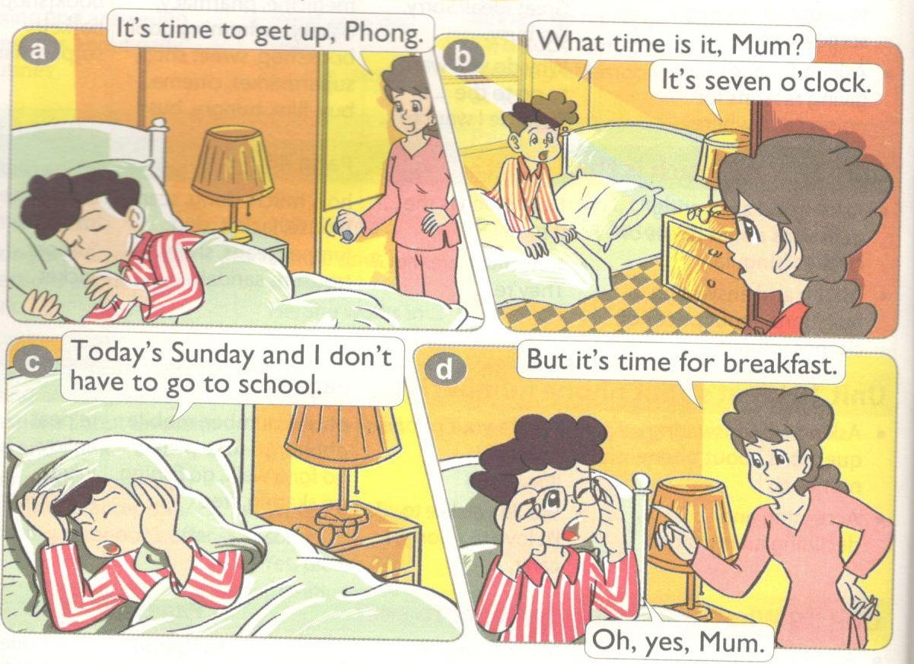
What new structure are you ?

Slide 6

2. Point and say:
1. Examples:
What time is it, Mum?
It’s seven o’clock.
What time is it ?: Mấy giờ rồi ?
>> It’s six o’clock.
twenty o’clock
2. Form:
What time is it ?
It’s + time (thời gian).

Slide 7
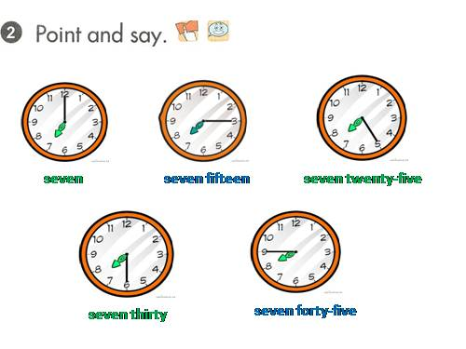
1.
2.
3.
4.
5.

Slide 8
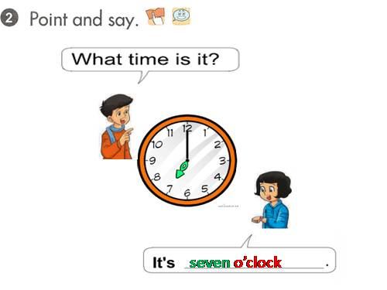
1

Slide 9
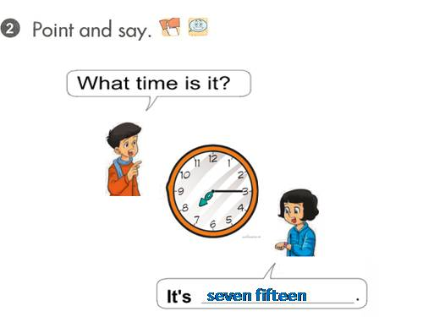
2

Slide 10
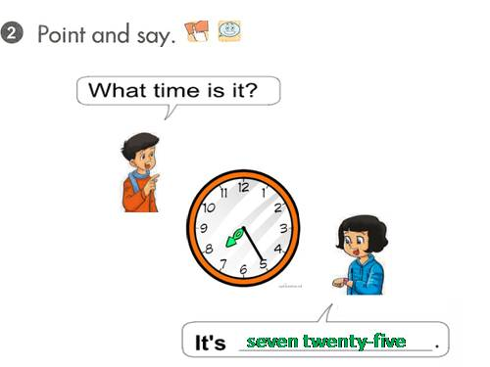
3

Slide 11
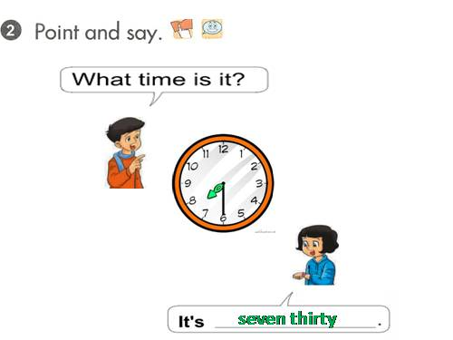
4

Slide 12
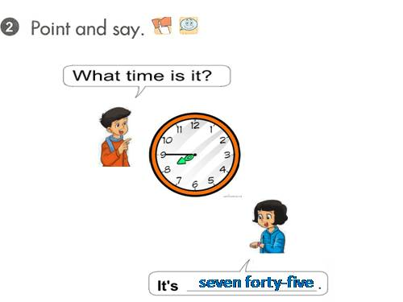
5

Slide 13
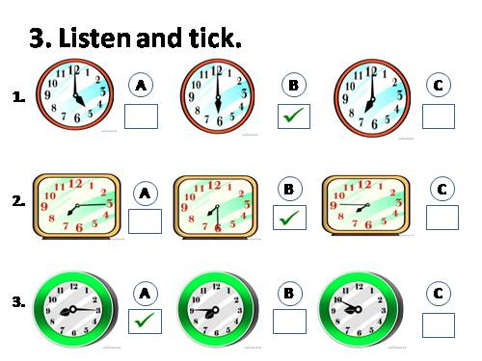

Slide 14
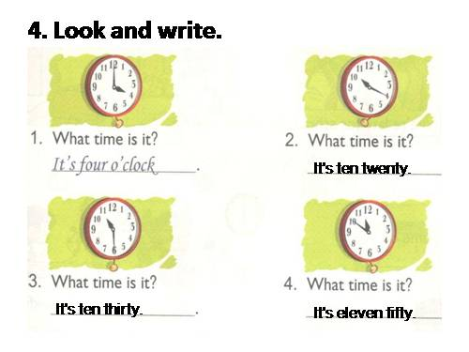

Slide 15
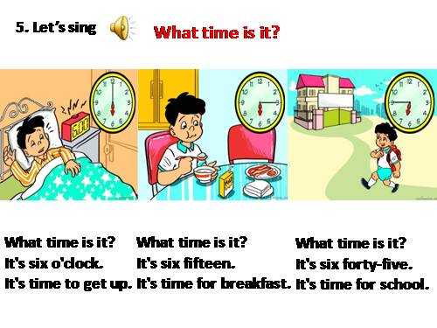

Slide 16

h o m e w o r k s
Review new words
Follow the conversation
Review song “What time is it ? ”

Slide 17


